Slide 1


WELCOME Clock School 101
What you’ll learn from your synchron® motor
Distinguishing Information
Model # explanation
Voltage, speed, cycles
Mounting characteristics
Wire colors
Replacement options
Mechanical
Solid-state

Slide 2

Scott DeSmith
Your presenter today
Product Application Specialist
Scott has been with American Time for the past 33 years. As a Product Application Specialist, customers continuously rely on Scott’s expertise in traditional synchronized time system solutions and legacy clock repairs to troubleshoot and solve their clock pain points.
Notes:
Talk about questions answered at end. As questions com up, use chat feature during presentation.

Slide 3
About Synchron® Motors
Made by Hansen Corporation in many types for a wide variety of applications.
The founder was a jeweler and watch maker and gained recognition when he designed the first automatic bell ringing system at the request of a local high school principal.
The ones we will be looking at today are most commonly use in:
HVAC – Damper and Valve Controls
Mechanical Timers
Clocks!
Chart Recorders
POP Displays
Notes:
Point out interesting fact about the founder of the Hansen Corporation.

Slide 4
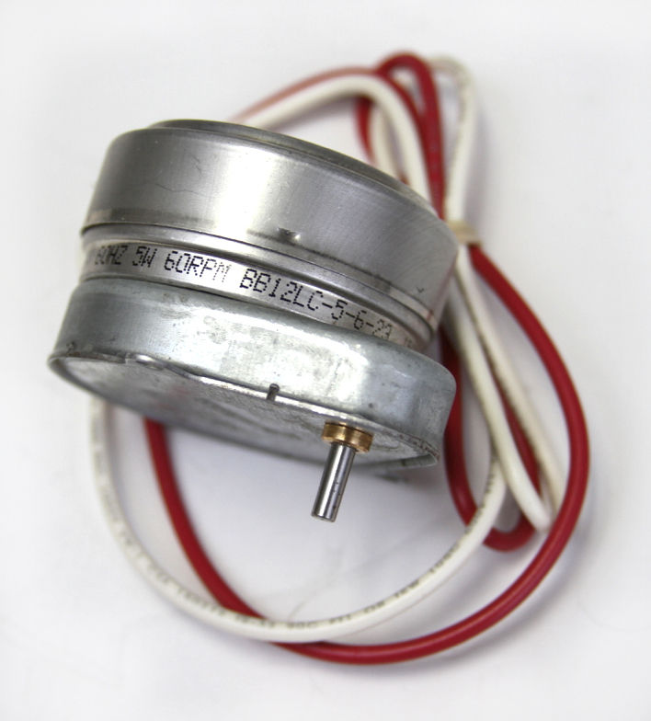
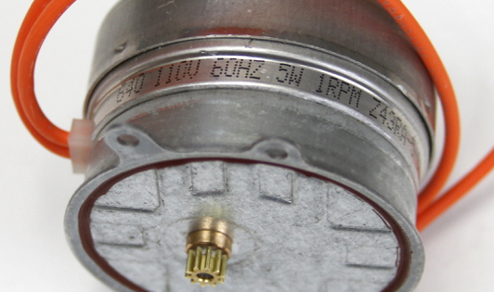
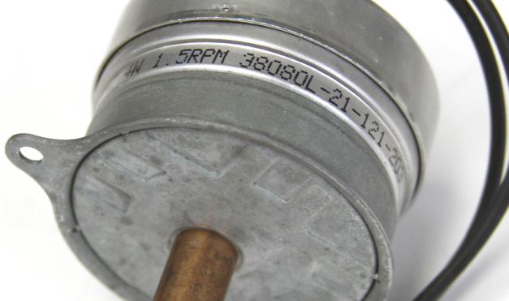
How to read your Synchron Motors
Model #
Voltage, Speed
Other Information
Sample: A 12 R A -3
V, Hz, RPM
Date Stamp, Custom Models
Notes:
Mention sample model # going to be used in next several slides

Slide 5
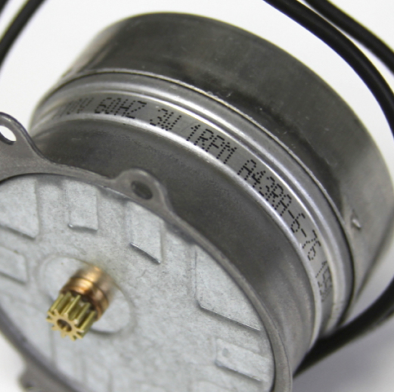
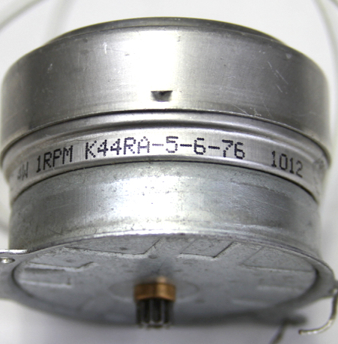
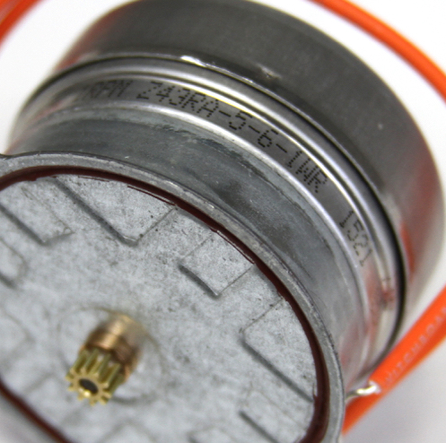
Sample Model # A 12 R A -3
Alphabetical characters shown in this position signify motor types.
Include lead length and stripping, lead position, lead color code and torque rating of motor.
EXAMPLE: “A” means 6” leads stripped 5/8 and in 6 o’clock position (standard), color (black 110v. 60cy.) and standard torque (3w) 8 in. oz. @ 1RPM.

Slide 6
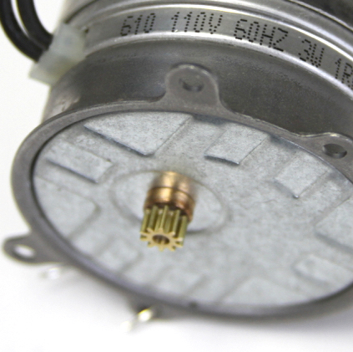
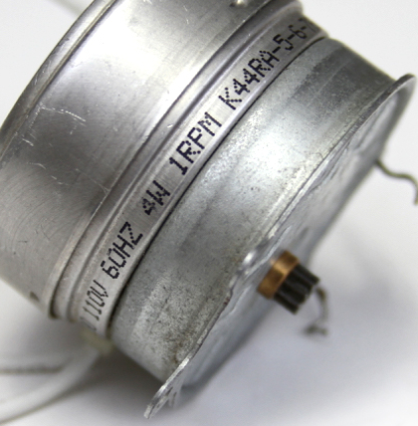
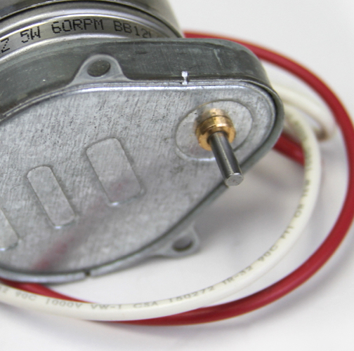
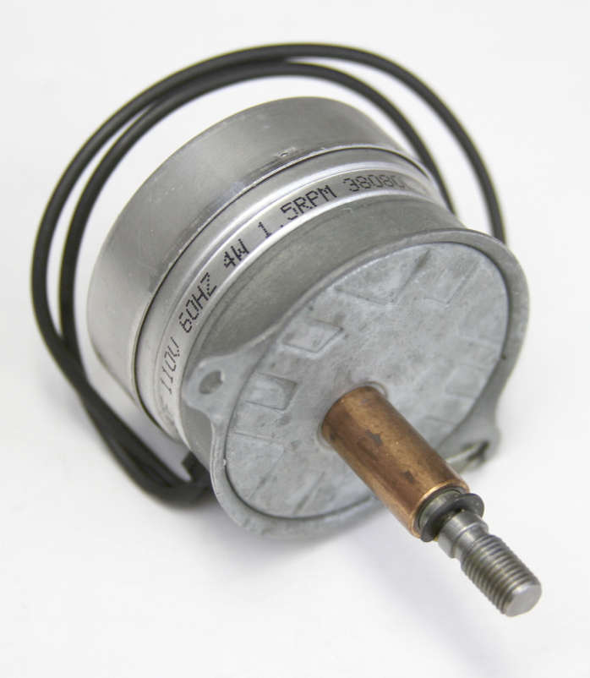
Sample Model # A 12 R A -3
Numeral after motor type is the type of output.
Diameter and length of hub, diameter and length of shaft and whether round, flatted, threaded or with pinion, crank or other device.

Slide 7
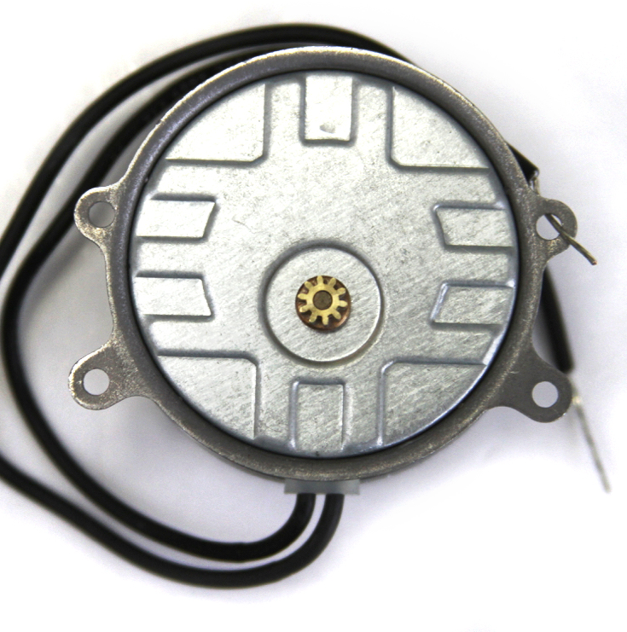

Sample Model # A 12 R A -3
Letter R (or L) signifies direction of rotation of shaft.
R=Clockwise and L=Counterclockwise when viewing output side of motor.

Slide 8
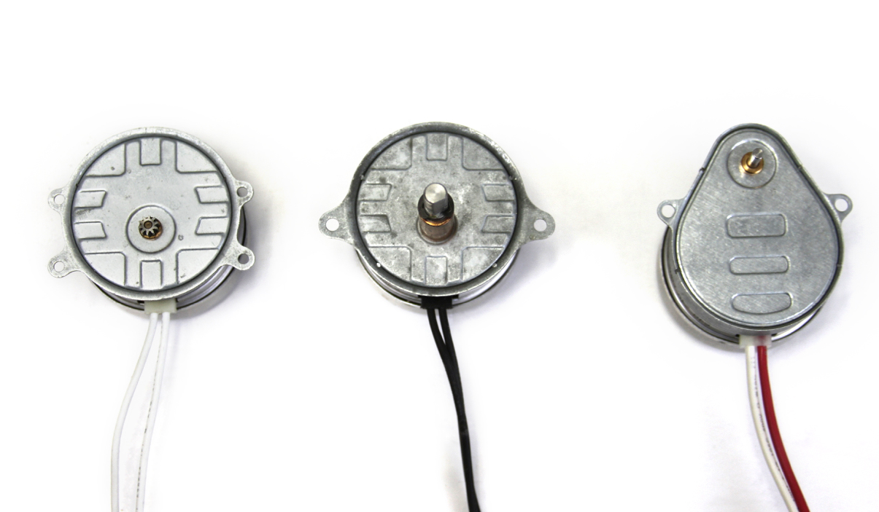
Sample Model # A 12 R A -3
Letter shown after “R” or “L” represents the style of mounting.
“A” in this instance is a round motor with 4 mounting lugs.

Slide 9
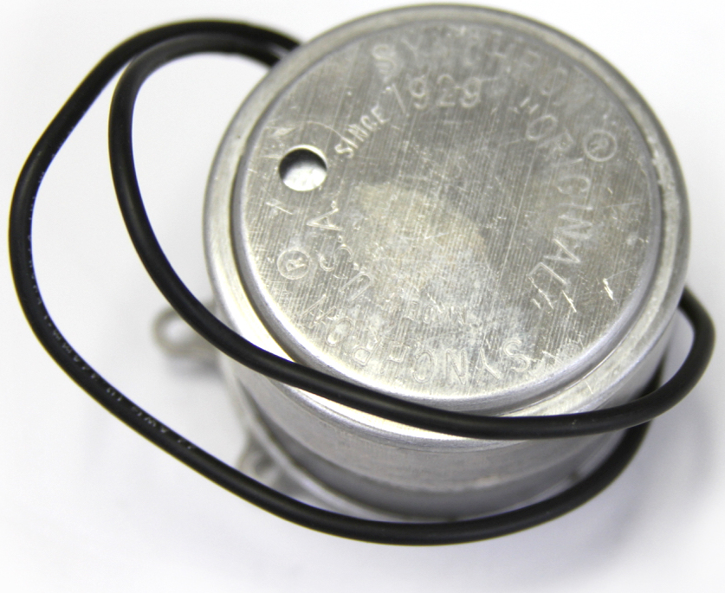
Sample Model # A 12 R A -3
Called dash numbers and is a hyphenated numeral denoting a special motor feature series.
Internal clutches, special tests, thrust positions Up or Down, reversible and tandem, plated motors & etc.

Slide 10
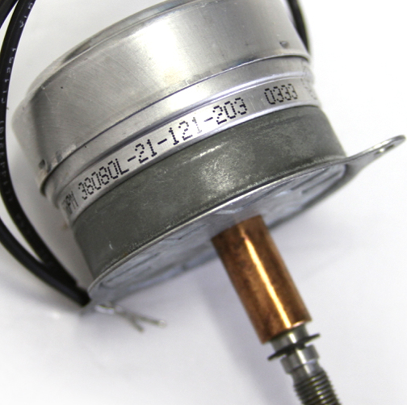
Voltage, Speed and Other Information
Output shaft speeds listed in RPM, RPH or RPD
Input volts
Cycles / Hz
Date stamping

Slide 11
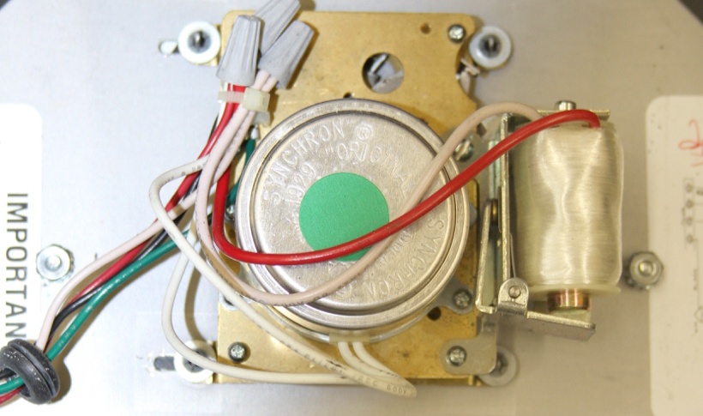
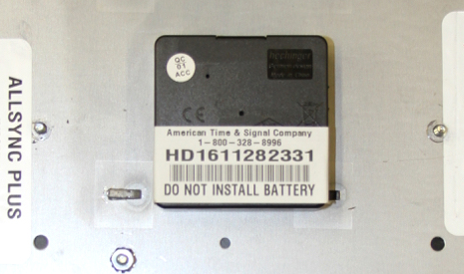
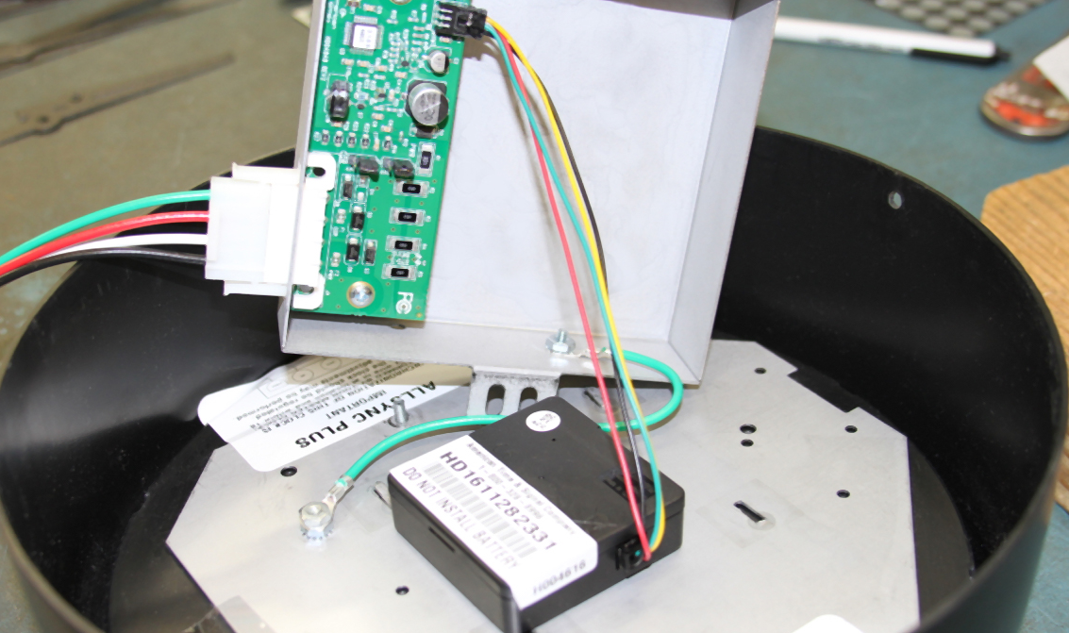
Replacement Options
Mechanical
Solid-State Movement
Circuit Board & Cover
Repair/Replace
Replace
Energy Savings
Molex® Connection

Slide 12
This ends our webinar
Thank You For Joining Us Today
Watch for upcoming Clock School webinars
Let us know what topics you’d like us to cover!
email us: marketing@atsclock.com
Subscribe to our Blog for current topics
blog.american-time.com
Contact us
800-328-8996
american-time.com
A recording of this has been made and will be available to you. Watch for email.
Notes:
At this time answer any questions that may have come up as time permits.
Talk about watching for upcoming webinars. Future topic recommendations.

